Slide 1

Project Financials Tutorial
Confidential
Created by Consultants previously from Deloitte, McKinsey & BCG

Slide 2

Table of Contents
Overview
Cash Flow
Cumulative Cash Flow
Net Present Value (NPV)
Payback Period
Internal Rate of Return (IRR)
Return on Investment (ROI)

Slide 3
Overview The Excel document “Lean Financial Model” includes 5 Excel sheets where you will have to input your data, and 2 Excel “output” sheets that will automatically update based on your input
Input your data in this 5 Excel sheets
This 2 Output sheets will be automatically updated based on your input
Project Initial Investment
Project Costs
Project Financials Summary
Additional Revenue Generated
Project Cash Flow Chart
Cost Savings
WACC

Slide 4
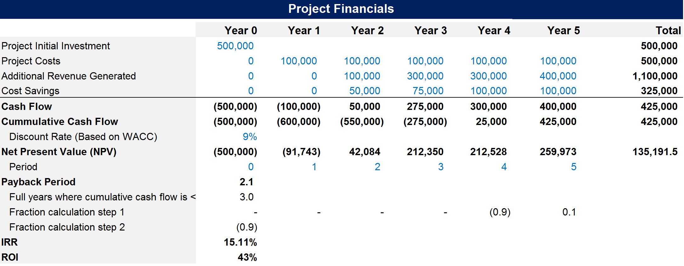
Timeframe Description
The most common timeframe to estimate the financial performance of a project is 5 years. Year 0 is the present day. Year 1 represents the first 12 months. Year 2 represents the period between 12 months and 24 months, etc.

Slide 5
Project Initial Investment Description
The Project Initial Investment represents the amount that you invest at the beginning of a project. It is usually a one-off cost that you need to input on Year 0.

Slide 6
Project Costs Description
The Project Costs represent the ongoing amount of money that you will be spending each year. It includes the labour cost required to implement the project.

Slide 7
Additional Revenue Generated Description
The Additional Revenue Generated represents the incremental revenue that the company will make due to the project. For example, you may estimate that the creation of a new product feature will increase your sales by 4%.

Slide 8
Costs Savings Description
Cost Savings represents the cost that the company will save due to the project. For example, if you replace an expensive material by a cheaper material to manufacture your products, you may decrease the cost of your products by 10%.

Slide 9
Cash Flow Description
Cash Flow represents the amount of cash that will be generated due to the project. The formula to calculate your Project Cash Flow is:
Additional Revenue Generated + Cost Savings - Projects Costs - Project Initial Investment.
The Project Cash Flow will usually be negative the first years and then become positive. If you estimate that it will never become positive, then you may decide to invest your money in a better performing project

Slide 10
Cumulative Cash Flow Description
Cumulative Cash Flow represents the total amount of cash that will be generated since the beginning of the project. The formula to calculate your Cumulative Cash Flow for, let’s say, Year 2 is:
Cash Flow on Year 0 + Cash Flow on Year 1 + Cash Flow on Year 2

Slide 11
Net Present Value Description
The NPV for, let’s say, the Year 2, is calculated like this:
Cash Flow on year 2 x (1/(1+Discount rate)^the period number
You’ll see in the next 2 slides what we mean by Discount rate and Period

Slide 12
Discount Rate Description
Because money today could be earning interest, a dollar received now is worth more than a dollar received in the future.
To reflect this principle, a Discount Rate is used to discount future net cash flows to present value.
A Company usually has a standard assumed Discount Rate provided by the Finance Department
This Discount Rate is often calculated based on the Weighted Average Cost of Capital (WACC), that is to say the cost of receiving money from your bank and shareholders
In our example, the Company has a Discount Rate (R) of 9%

Slide 13
Period Description
In order to calculate your Net Present Value, you will also have to use the Periods. Year 1 is the period 1, Year 2 is the period 2, etc.

Slide 14
Payback Period Description
The Payback period is the amount of time (usually measured in years) it takes to recover the project investment. In other words, it is the breakeven point. In our example, it is easy to see that we needed more than 3 years to breakeven. To know exactly how much more, we need to create 3 rows that will help us calculate the exact breakeven point.

Slide 15
The 3 required rows to calculate Payback Period Description
In order to calculate the Payback period, you need to create:
A row to calculate the number of years of negative cumulative cash flow
A row to calculate the fraction for each year which do not have a negative cumulative cash flow
A row that will identify the relevant fraction, that will be added to the number of negative cumulative cash flow. In our example, the fraction that we need is the one on Year 4.

Slide 16
Payback Period Description
The payback period will simply be your number of negative cumulative cash flow + the fraction of the first year of positive cash flow

Slide 17
Internal Rate of Return (IRR) Description
IRR is the rate of growth a project is expected to generate
To calculate IRR, you simply need to:
Use the IRR excel formula by inputting “=IRR(” in the relevant cell
Select your cash flow from year 0 to year 5
Close the bracket “)”

Slide 18
Return on Investment (ROI) Description
ROI is simply calculated with the formula below:
How much money you’ve made divided by how much money you’ve spent

Slide 19









Interested in more Business & Consulting Toolkits? Our ex-McKinsey, Deloitte & BCG Consultants created 10 Toolkits including practical Frameworks, Tools & Templates
1.Corporate & Business Strategy Toolkit
2.Management Consulting Toolkit
3.Change Management Toolkit
4.Project Management Toolkit
5.Sales, Marketing & Communication Toolkit
Visit Website
Visit Website
Visit Website
Visit Website
Visit Website
6.Finance and Mergers & Acquisitions Toolkit
7.Digital Transformation Toolkit
8.Operations & Supply Chain Toolkit
9.Leadership Skills Toolkit
10.Legal Toolkit
Visit Website
Visit Website
Visit Website
Visit Website
Visit Website

Slide 20

Interested in multiple Business & Consulting Toolkits? Get access to all our Toolkits for half the price with the Gold Business & Consulting Package
Gold Business & Consulting Package
Learn More
www.slidebooks.com

Slide 21



Need more help? Hire one of our Management Consultants for $4,000 a day
Learn More

Slide 22
Thanks for your attention!
www.slidebooks.com

